Slide 1

Smart City
Urban Well-being Analysis and Intervention System
Group 64:
Yulun Feng
Yuelu Zhang

Slide 2
Project Overview & Our Objective
Vision
Mission
Values
To work together to be a First Hotel Brand for young people and Top 1 successful Canadian hotel group.
A total commitment to provide quality and ethical services with new technology to all our customers, clients and partners at all times
Our client wants to ensure the quality service and products are provided to their guests at competitive prices.
Our client strives for a fair return of investment for our stakeholders by practising good management ethics.
Notes:
Yuelu Zhang

Slide 3
System Features
Real-time data collection
Wellness Scoring System
Root Cause Identiication
Customers experiencing the cost of hotel in Canada to be relatively high, affecting their perception of value for money.
In popular tourist destinations or during peak travel seasons, customers might face difficulties in finding available rooms, they have limited choice. Booking platforms and hotel policies also add to the complexity, such as non-refundable bookings or hidden fees.
Customers increasingly expect seamless digital experiences, from booking to check-out. Hotels that fail to offer user-friendly online interfaces, efficient online customer service, or might lose potential travelers.
Notes:
Yuelu Zhang

Slide 4
System Architrecure
High Price
Availability Challenges
Technological Integration
Customers experiencing the cost of hotel in Canada to be relatively high, affecting their perception of value for money.
In popular tourist destinations or during peak travel seasons, customers might face difficulties in finding available rooms, they have limited choice. Booking platforms and hotel policies also add to the complexity, such as non-refundable bookings or hidden fees.
Customers increasingly expect seamless digital experiences, from booking to check-out. Hotels that fail to offer user-friendly online interfaces, efficient online customer service, or might lose potential travelers.
Notes:
Yulun Feng

Slide 5
UI/UX Wireframes
Canadian Hotel market experiencing rapid growth and evolution driven by advancements in technology and changing consumer preferences. As our brand strives to enhance guest experiences, streamline operations, and maximize efficiency, the need for a comprehensive and efficient hotel management system becomes crucial for the next expanding plan. Moreover, with the rise of online booking platforms and the increasing popularity of using mobile devices for travel planning, hotels must adapt by offering seamless online reservation systems and guest-facing mobile applications for various hotel services.
Notes:
Yuelu Zhang

Slide 6
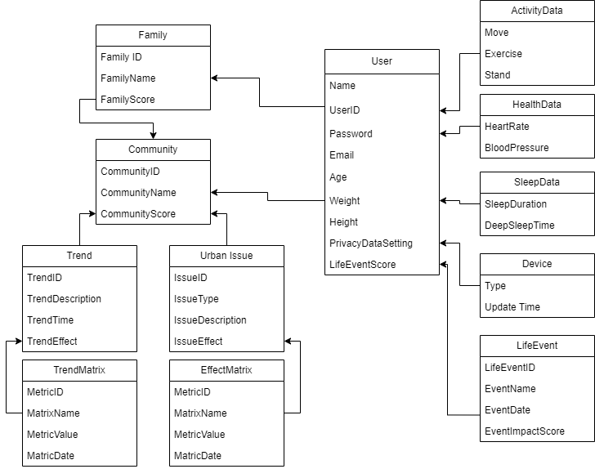
Domain Model
High Price
Technological Integration
Notes:
Yulun Feng

Slide 7
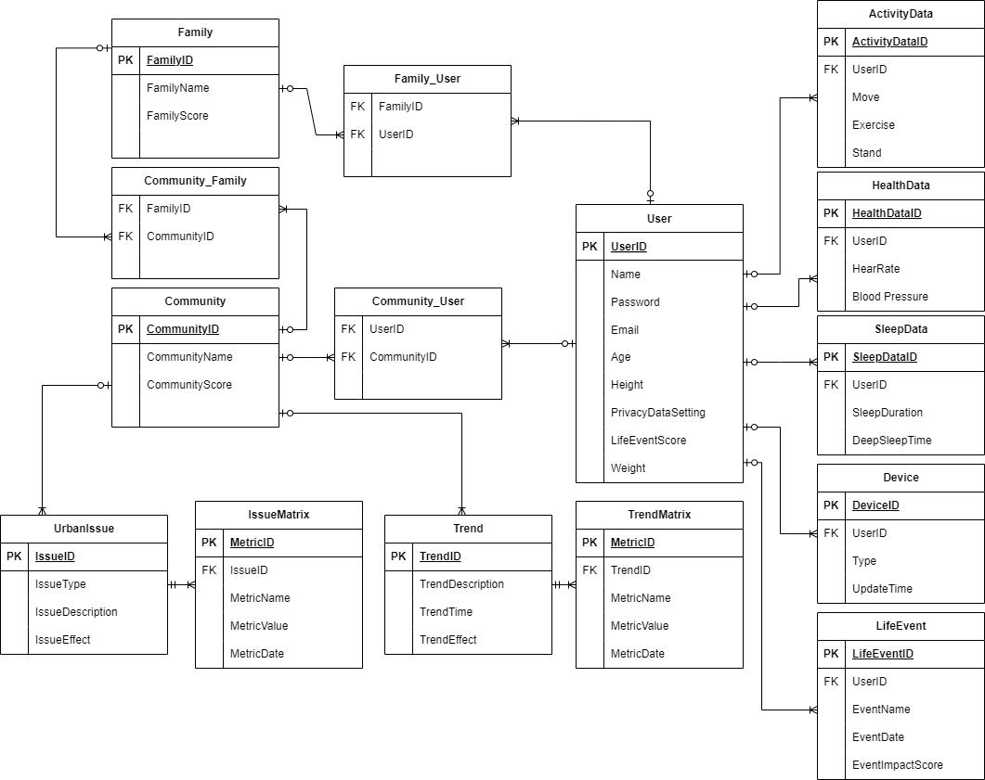
System Database Schema (Encrypted SQL)
Notes:
Yulun Feng

Slide 8
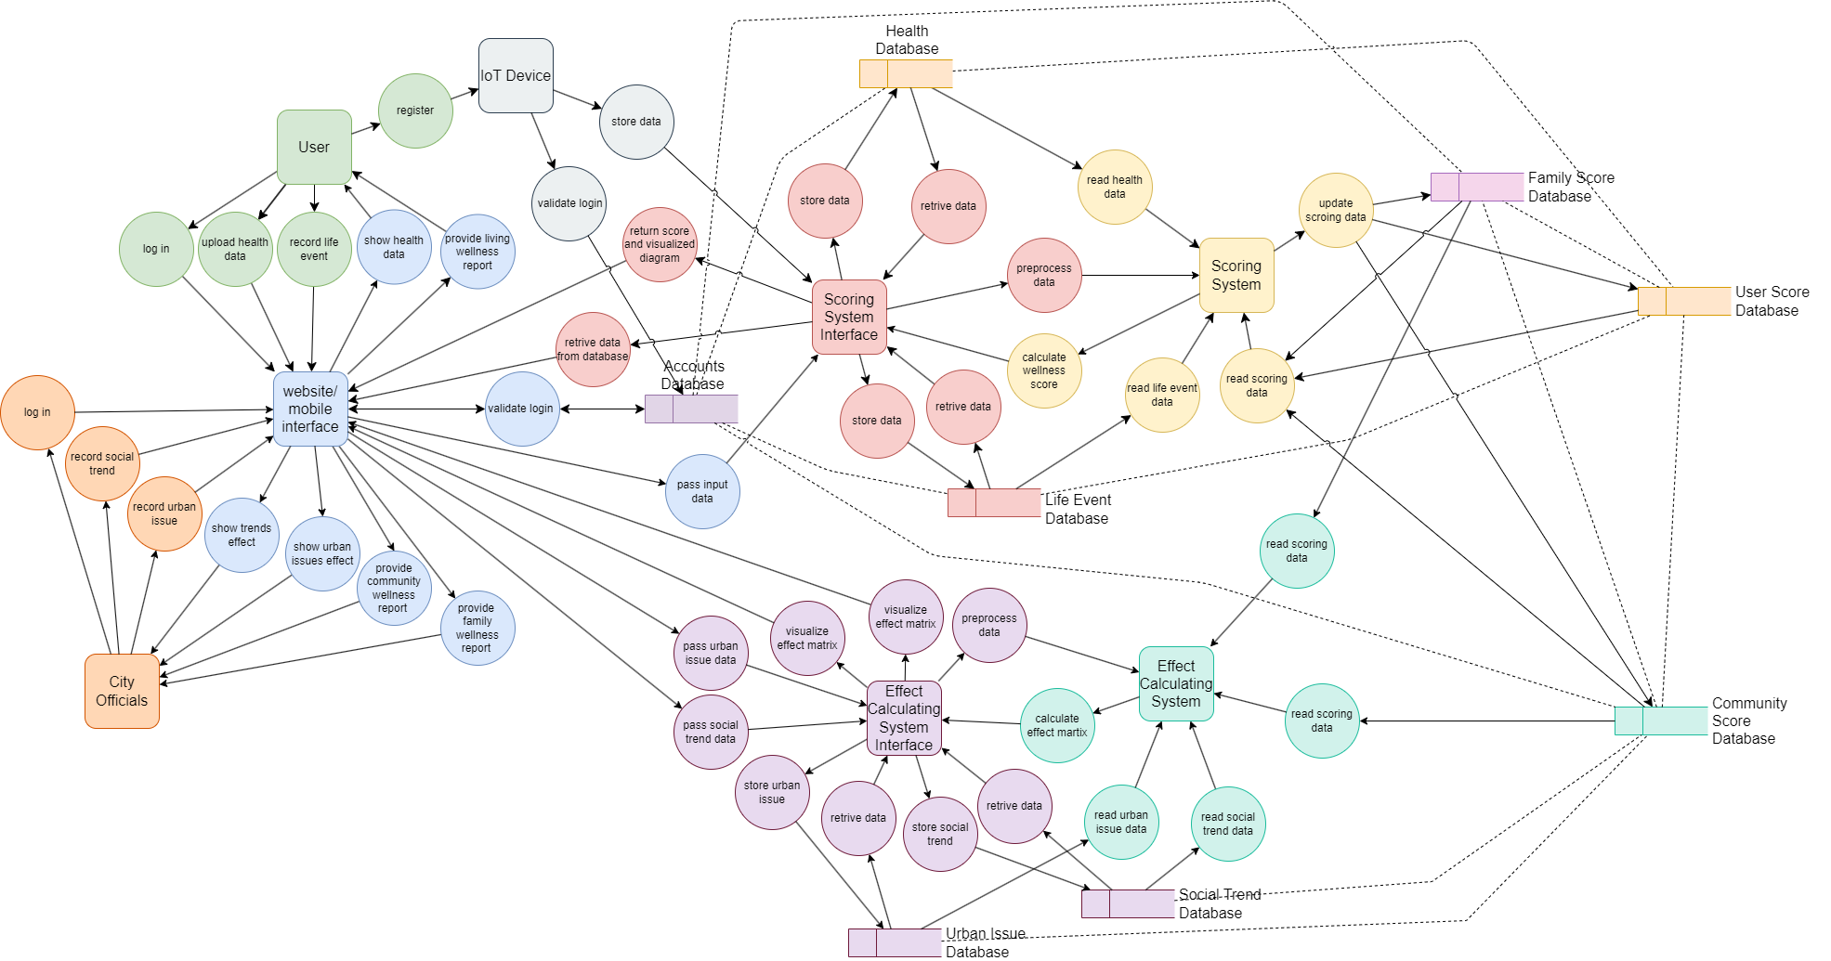
System Data Flow
Notes:
Yulun Feng

Slide 9
Data Analysis Strategy
Collect & Preprocess
Weight Calculation
Machine Learning
Family and Community Level Adjustment
Phase 2
Load Data from database
Data Cleaning
Data Normalization
Encode Categorical Data
Package used:
pandas
numpy
scipy.stats
sklearn.preprocessing
Define Key Metrics
Assign Weight
Calculate Individual Score
Aggregate Wellness Score
Package used:
pandas
numpy
Load pre-trained model
Fine-tune the model
Predict adjustment
Combine Predictions with Weighted Score
Packages used:
transformers
tokenizer
datasets
Retrieve data
Apply family-level adjustment
Calculate family wellness score
Calculate community score
Adjust for social trends
Packages used:
numpy
pandas
sklearn.preprocessing
Notes:
Yulun Feng

Slide 10
Challenge Scenarios & Solution Demonstration
1. Constructing a new hospital
2. Implementing a comprehensive health education program
Notes:
Yulun Feng

Slide 11
Challenge Scenarios & Solution Demonstration (cont.)
3. Investing in youth intervention programs
4. Expanding economic opportunity initiatives
Notes:
Yulun Feng

Slide 12
Privacy Policy and Ethic Considerations
Privacy and Security
User Consent
Ethical Data Use
Technological Integration
Legal and Regulatory
Data Encryption
Access Control
Data Anonymization & Pseudonymization
Data Access Logs and Audits
Informed Consent
Data Sharing Preferences
Data Retention Policy
Right to Deletion
Purpose Limitation
Non-Discrimination
Transparency in AI Algorithms
Regulatory Compliance
Privacy by Design and Default
Ethics Board Review
End-User Accountability and Support
Notes:
Yuelu Zhang

Slide 13
Real-World Impact and Scalability
Technological Integration
Notes:
Yuelu Zhang

Slide 14
Thank you!

